Slide 1
HOUSE

Slide 2
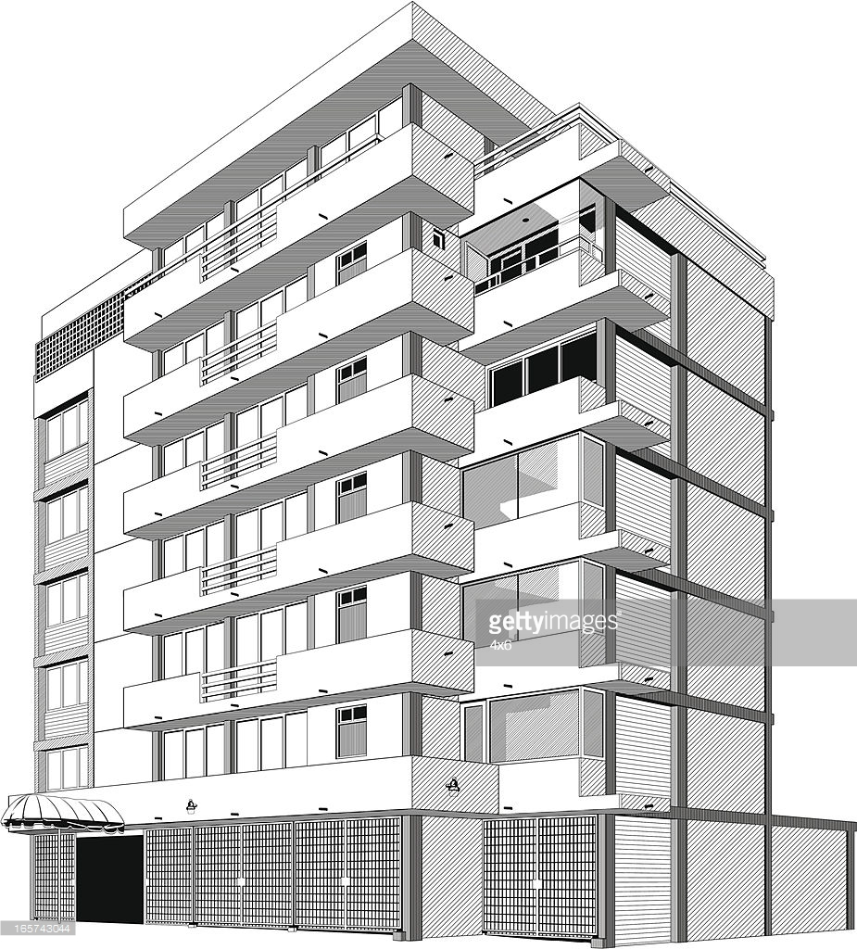
BLOCK OF FLATS

Slide 3
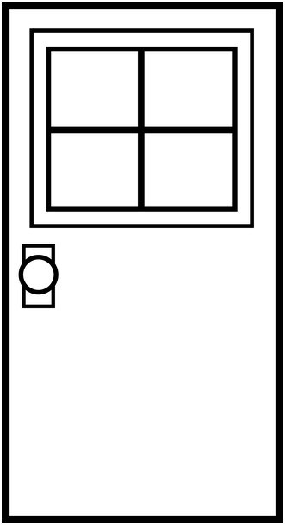
DOOR

Slide 4
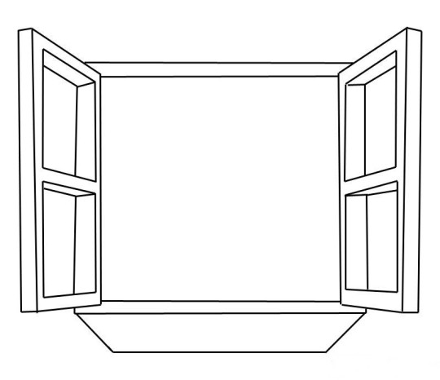
WINDOW

Slide 5
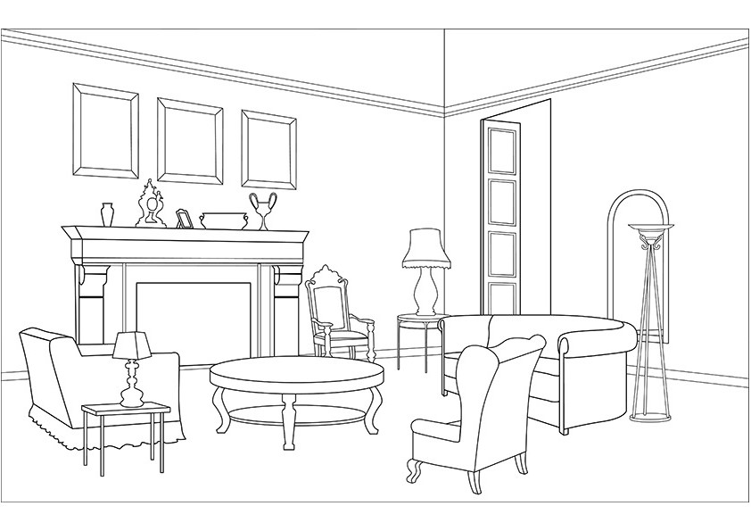
SITTING ROOM LIVING ROOM

Slide 6
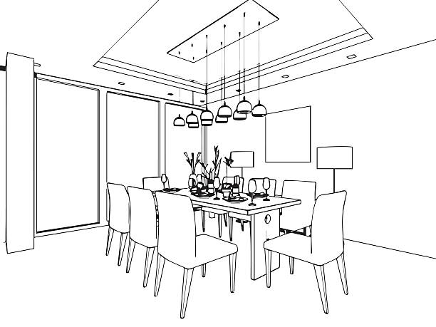
DINING ROOM

Slide 7
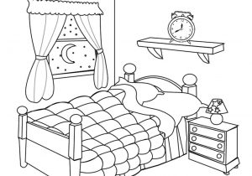
BEDROOM

Slide 8
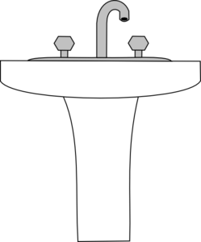
BATHROOM

Slide 9
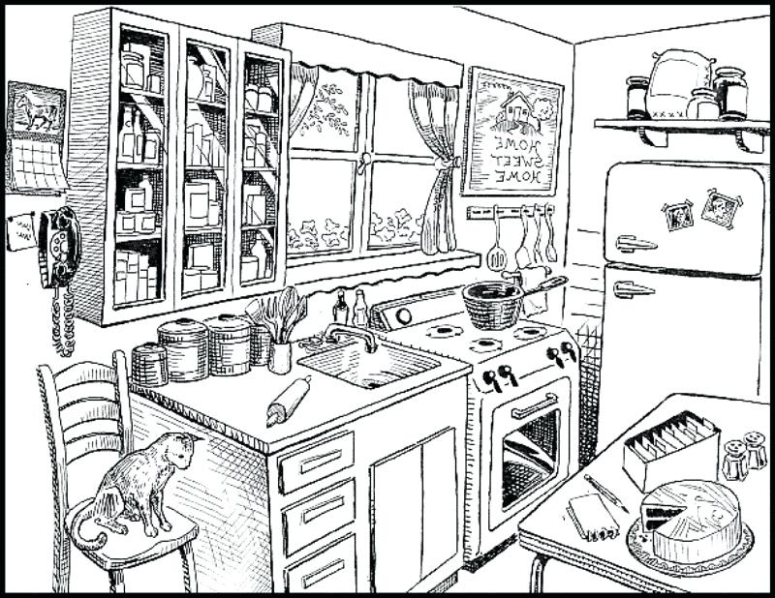
KITCHEN

Slide 10
GARDEN

Slide 11
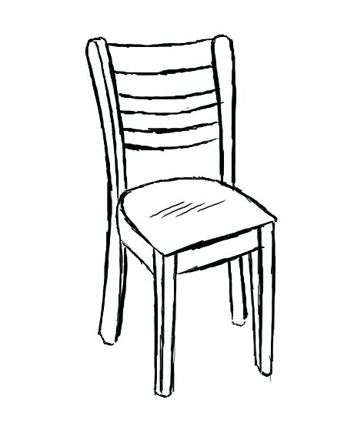
CHAIR

Slide 12
ARMCHAIR

Slide 13
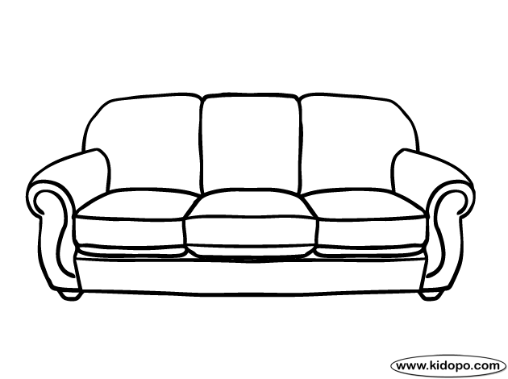
SOFA
COUCH

Slide 14
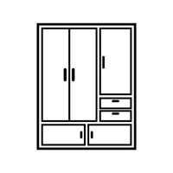
WARDROBE

Slide 15
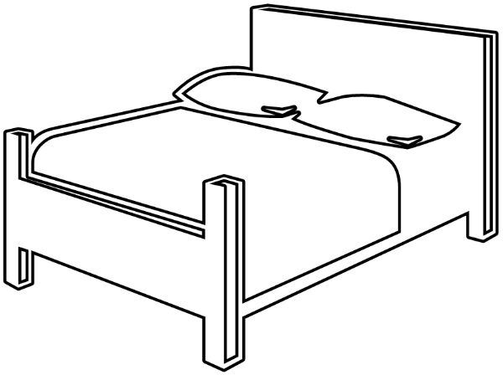
BED

Slide 16
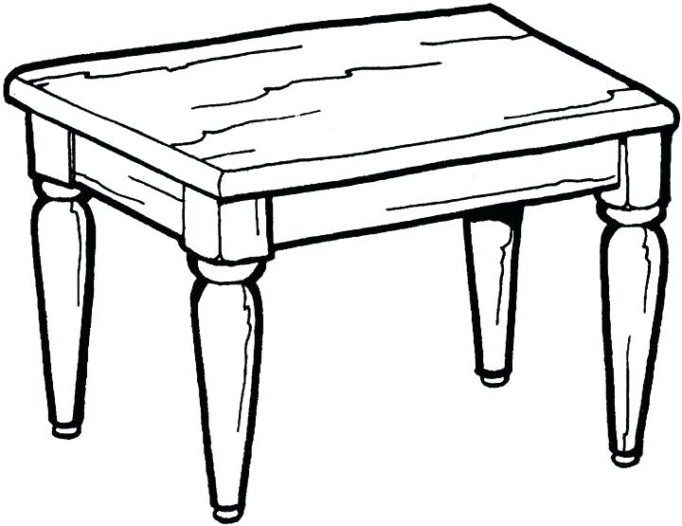
TABLE

Slide 17
BOOKCASE

Slide 18
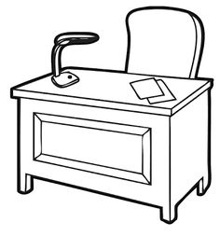
DESK

Slide 19
BEDSIDE TABLE NIGHT TABLE

Slide 20
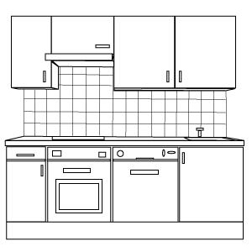
CUPBOARDS

